Slide 1
Inverse design of 2D wave devices with optimization
Egor Nuzhin, Iurii Minin, , Alexey Boyko
Notes:
Hello everyone! We are teem TOPoprers. My name is Egor Nuzhin and my teammate is Iurii Minin. Unfortunately, Alexey Boyko coudn’t come (he is in the class). Our project topic is inverse design of 2d wave devices with optimization.

Slide 2
Problem
Modeling of interaction of electromagnetic waves in conducting medium
Representation of electromagnetic waves animations
Topological optimization of electromagnetic wave based devices
Notes:
Problem, that we solved, it is : Modeling and Representation of interaction of electromagnetic waves in conducting medium, And Topological optimization of material for wave based devices

Slide 3
Existing methods
Direct solution of Maxwell equations
Experimental observing
Numerical methods
Notes:
Actually, this problem solved Numerically, since to compute field analytically for complex forms is very hard

Slide 4
Who cares?
Physics based studying of electromagnetic waves entity
Radio photonics
Topological optimization of size and performance of photonics devices
HUAWEI, CISCO, INTEL, SAMSUNG, IBM
Notes:
Our work may be interested for physics based studying (when we can see or may be touch field by hand). Radio phoenix is also important area, where such research are often used. And most important sub topic is topological optimization of size and performance of photonics devices. Such companies like HUAWEI, CISCO, INTEL, SAMSUNG, IBM preform such studies intensively,

Slide 5
Main wave integral equations (Integral form of Helmholtz equation)
Electromagnetic intensity distribution in vacuum
Required field
Green function
Permittivity
Wavenumber
Hankel function
Notes:
Our project is based on the following integral equation. This formula represent real field E in some area with permittivity distribution e, if in a vacuum it was represented by F

Slide 6
Wave equation descretization (One type of materials)
Constatnt
Mask: {0,1}
Notes:
This system may be discretized and, in our partition case for constant epsilon and arbitrary mask, expressed in the following vectorized format.

Slide 7
Non convex topological optimization problem
s.t
Notes:
Now we can formulate optimization problem, We want to maximize power of electromagnetic wave in some point. This problem is discrete, so o solve it using continuous optimize we need to relax it.

Slide 8
Penalization of optimization problem
s.t
Notes:
Penalized optimization problem represented on the slide.

Slide 9
Optimization acceleration (Jacobi matrix)
Notes:
And finaly, to solve this problem fast we have coupled Jacobian

Slide 10
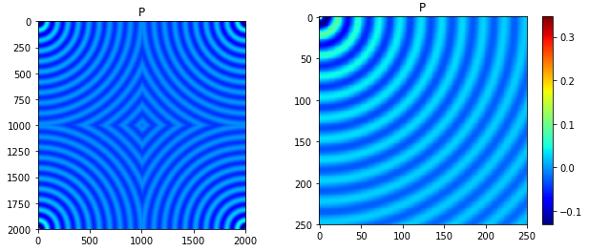
FFT matvec for G product
Size G is n² x n²!
But since G is toeplitz matrix we can use fast FFT matvec
We don’t store full matrix usung FFT matvec linear operator (size ~n x n)
Circulant matrix
(Surrogate of G)
Toeplitz block of G

Slide 11
Some examples of work of our solver (in Python). Initialization.
F =
+ j∙

Slide 12
Circular mask (𝞮 = 1.5)

Slide 13
Rectangular mask (𝞮 = -10)

Slide 14
Converges of GMRES Solver (grid 512✕512)

Slide 15
Results of optimization. Initialization
For this task we have used grid 16✕16, since optimization is more hard computing task
F =
+ j∙

Slide 16
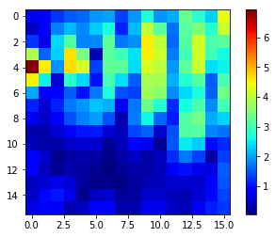
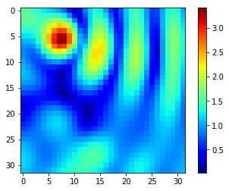
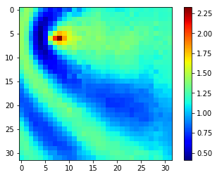
Some optimization examples on continuous 𝝴 grid

Slide 17
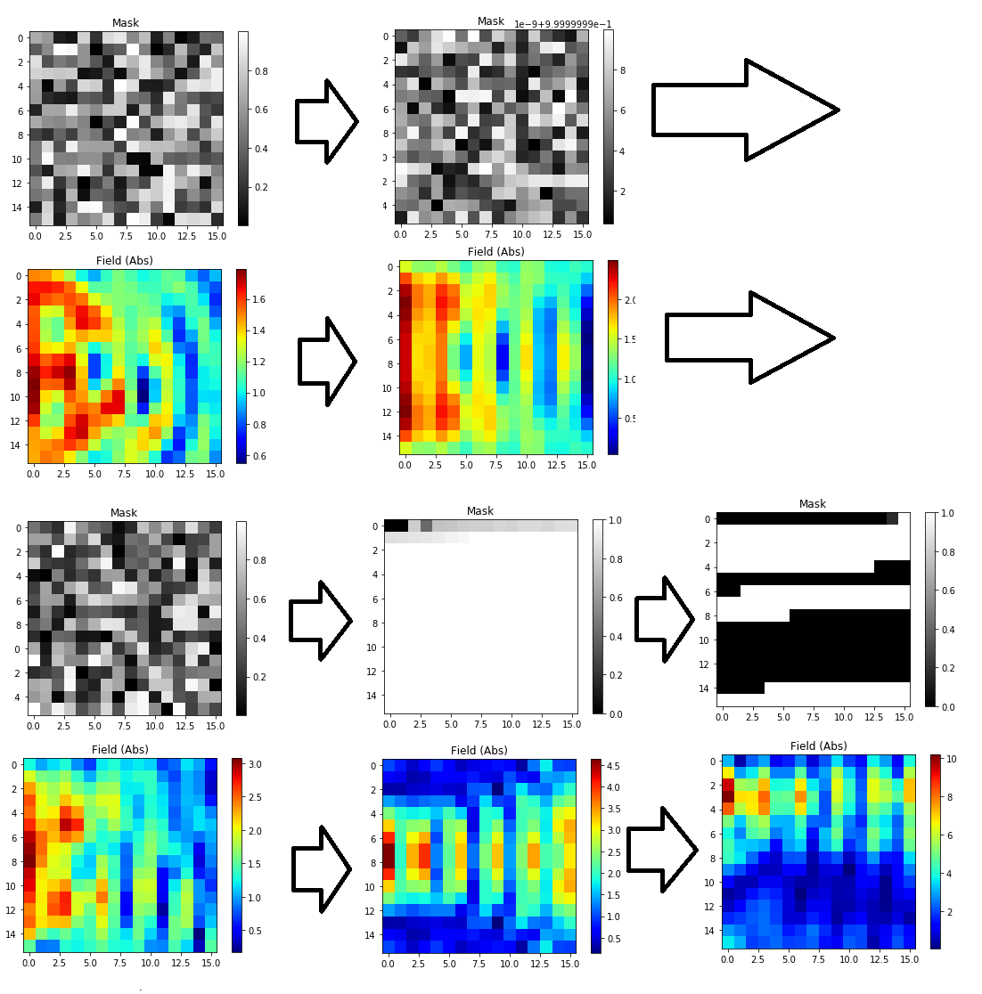
Discrete mask case

Slide 18
Thank you

